Slide 1


JAVA INTERVIEW BOOTCAMP
Lecture 9

Slide 2

Today’s Agenda
Types Of Variables
Categories Of Variables
Properties Of Variables
Comparison Between Reference & Primtives

Slide 3
Types Of Variables
Before we can discuss types of variable provided by Java , we need to understand their categorization types.
Broadly there are 2 categorizations of variables:
Categorization according to content
Categorization according to place of declaration

Slide 4
Categorization On Content
Based on what a variable can store , Java has 2 types of variables:
Primitives : for holding values
References: for holding address
Qn: How many types of primitives Java provides ?
An: 8
Qn: How many types of references Java provides ?
An: 4
(strong,soft,weak and phantom)

Slide 5
Categorization On Declaration Point
Based on where a variable has been declared it could be categorized in 3 types:
Instance variables
Static variables
Local variables
Instance Variable:
If the value of a variable varies from object to object then it
must be declared as instance variable.

Slide 6
Properties Of Instance Variables
1. COPIES:
Java always creates separate copies of instance variables for
each object.
2. DECLARATION LOCATION
They must be declared within the class but outside any
method body or any kind of block.

Slide 7
Properties Of Instance Variables
3. MEMORY LOCATION
They are created inside heap i.e. the same place where
objects resides.
Example:
class Person
{
String name;
int age;
String gender;
}
class UsePerson{
public static void main(String[] args){
Person p1=new Person();
Person p2=new Person();
Person p3=new Person();
}
}

Slide 8
Properties Of Instance Variables
4.LIFETIME & SCOPE
They live and die with the objects.
Their scope is same as the scope of the object.
5. ACCESS POINT
They can only be accessed from non-static context implicitly
while from a static context they can be accessed explicitly

Slide 9
Example
class Demo
{
private int x=10;
public static void main(String [ ] args)
{
System.out.println(x);
Demo obj=new Demo( );
System.out.println(obj.x);
display( );
}
public void display( )
{
System.out.println(x);
}
}
Error! non static variable x cannot be referenced from a static context
Error! non static method display( ) cannot be referenced from a static context

Slide 10
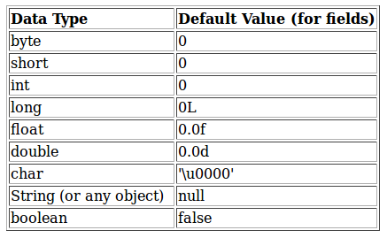
Properties Of Instance Variables
6.DEFAULT VALUES
JVM provides default values for instance variables at the time
of object creation if not explicitly initialized by the
programmer

Slide 11
Properties Of Instance Variables
7.ALTERNATE NAMES
They are also alternatively called as:
Object level variables
Instance Fields
Attributes
Properties

Slide 12
Categorization On Declaration Point
Static Variable:
If the value of a variable does not varies from object to object
then it must be declared as a static variable rather than instance
variable
Example:
class Emp
{
String name;
int age;
String gender;
static String organization = “SCA";
}

Slide 13
Properties Of Static Variables
1. COPIES
Java always creates single copy of static variables to be shared
amongst every object of the class.
2.DECLARATION POINT
They are always declared at the class level i.e. outside any block
3. CREATION & LIFE TIME
They are created at the time of class loading and destroyed
when class gets unloaded.

Slide 14
Properties Of Static Variables
4. SCOPE
Their scope is same as the scope of the class.
5. ACCESSING
They can be accessed either by using object reference or by
using class name , but accessing using class name is
recommended.
However within the same class even using class name is also
not required.

Slide 15
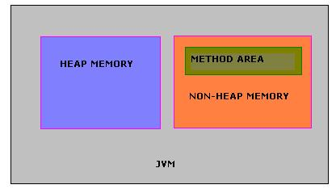
Properties Of Static Variables
6.LOCATION IN MEMORY
They live in a special area called the method area.
Method area is part of non-heap memory and it stores
per-class structures, code for methods and constructors.
Per-class structure means runtime constants and static fields.

Slide 16
Example
class Demo
{
private static int x=10;
public static void main(String [ ] args)
{
System.out.println(x);
Demo obj=new Demo( );
System.out.println(obj.x);
obj.display( );
}
public void display( )
{
System.out.println(x);
}
}
Correct! static variables can be accessed from a static context
Correct! static variables can be accessed from non static context also

Slide 17
Example
class Demo
{
private static int x=10;
private int y=20;
public static void main(String [ ] args)
{
Demo obj1=new Demo( );
obj1.x=500;
obj1.y=600;
Demo obj2=new Demo( );
System.out.println(obj2.x);
System.out.println(obj2.y);
}
}
OUTPUT:
500
20

Slide 18
Properties Of Static Variables
7.DEFAULT VALUES
JVM provides default values for static variables at the time
of object creation if not explicitly initialized by the
programmer

Slide 19
Properties Of Static Variables
8.ALTERNATE NAMES
They are also alternatively called as:
Shared Variables
Class Fields
Class Variables

Slide 20
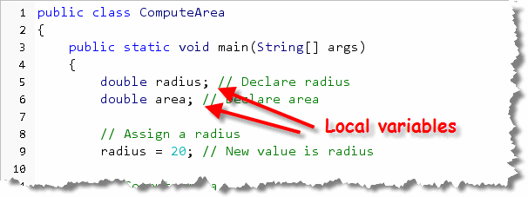
Categorization On Declaration Point
Local Variable:
If we want to store a value for a temporary period of time then
we declare local variables
Example:

Slide 21
Properties Of Local Variables
1. DECLARATION LOCATION
Java local variables are variables defined inside a method or
inside a block or method parameters.
2.COPIES
A new copy created every time we visit the block /method in
which it is declared
3. MEMORY LOCATION
They are also called as stack or automatic variables since they
live in method stack

Slide 22
Properties Of Local Variables
4.DEFAULT VALUE
They will not be given a default value
They must be always initialized before we attempt to access
them.
5.CREATION TIME & SCOPE
They are created as soon as the execution of their declaration
block begins and they die as the blocks execution gets over
6.ACCESSING
Directly by their name , no need for any object name or class
name to be used with them

Slide 23
Example
class Demo
{
public static void main(String [ ] args)
{
int i=0;
for(int j=0;j<=3;j++)
{
i=i+j;
}
System.out.println(i+”,”+j);
}
}
Error! Cannot find the symbol j

Slide 24
Example
class Demo
{
public static void main(String [ ] args)
{
try
{
int x=Integer.parseInt(“five”);
}
catch(Exception e)
{
x=5;
}
finally
{
System.out.println(x);
}
}
Error! Cannot find the symbol x

Slide 25
Example
class Demo
{
public static void main(String [ ] args)
{
int x;
try
{
x=Integer.parseInt(“five”);
}
catch(Exception e)
{
x=5;
}
finally
{
System.out.println(x);
}
}
Error! Variable x might not have been initialized

Slide 26
Example
class Demo
{
public static void main(String [ ] args)
{
int x;
if(args.length==0)
{
x=1;
}
else if(args.length!=0)
{
x=2;
}
System.out.println(x);
}
}
Error! Variable x might not have been initialized

Slide 27
Modifiers Allowed With Local Variables
Which modifiers are allowed with local variables ?
private
public
static
transient
final
volatile
Answer:
1,2,4,5,6

Slide 28
Object References
Objects are instances of classes, including both predefined and user-defined classes.
For a reference type in Java, the variable name evaluates to the address of the location in memory where the object referenced by the variable is stored.
An object reference is, in fact, a memory address that points to a memory area where an object’s data is located.

Slide 29
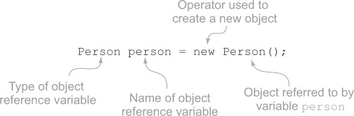
Creation And Assignment
When the above code executes, five things happen:
A new Person object is created.
It’s members are initialized with default values
Default constructor gets called
A variable named person is created in the stack .
The variable person is assigned the memory address value where the object is located.

Slide 30
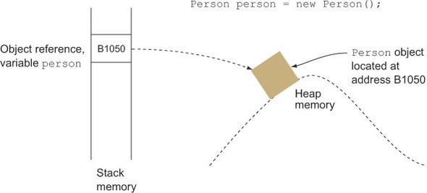
Memory Diagram

Slide 31
Primitives V/s References
Category | Object Reference | Primitive Variables
Storage | Stores Address | Stores Values
Determination Of equality | Uses == for reference comparison and equals( ) for object comparison | Uses only == for value comparison
Count of types | Although they are of 4 types , but mainly only strong references are popular | They are of eight types
Literal Value | Only null is the allowed literal | Different for different types, 0,false,0.0 etc
Garbage Collection | Objects reclaimed by garbage collector when not being referred any more | No concept of garbage collection
Operators | Limited Operators allowed | Almost all operators allowed

